Slide 1
Chapter 3 - Functions
Learning outcomes:
Describe the principles of structured programming
Apply function prototyping, definition, & calling
Discuss the scopes & storage classes of variables
Explain function calls stack, & activation record
Apply passing arguments to function
Analyze recursive, inline, & overloaded functions
Describe & apply default arguments in functions

Slide 2
Introduction
“Structured programming” (1960s)
use “divide-and-conquer” technique
one big problem (main) divided into a set of smaller tasks,
each tasks are implemented using a “function”
so constructs a program from a set of smaller pieces or modules/components, instead of
one long main program (or “spaghetti code”)
a “top-to-down” (or “boss-to-worker”) relationship b/n modules
a boss (i.e., the calling function or caller) asks a worker (i.e., the called function or responder) to perform a task,
and return the results when the task is done (i.e., report back)

Slide 3
Cont’d…
Function
a group of statements that perform a particular task or group of tasks.
Modularization
structure a program into smaller & more manageable pieces or modules
facilitate the design, implementation, operation & maintenance of large programs
Reusability
“write only once, use many time”,
can be called multiple times in a program, or included any number of times in different programs

Slide 4
C++ Functions
Standard functions,
“built-in functions”, came with the C++ language
prepackaged under the C++ standard library,
above 51 standard libraries // #included
e.g., math functions declared in:
#include <cmath> // #include <math.h>
User-defined functions
newly developed from scratch by users/programmers
e.g., martixAdd() // a function to add matrixes
can be also organized into a library
e.g., “matrix.h” // #include “matrix.h”

Slide 5
The Standard Math Library Functions
Perform common mathematical calculations,
included in <cmath> header file // or <math.h>
most functions take double, & return double
Functions called,
syntax: funcName(argument1, argument2, …, N);
Example
sqrt(double x); // return the square root of x
cout<<sqrt(900.0); // output 30

Slide 6
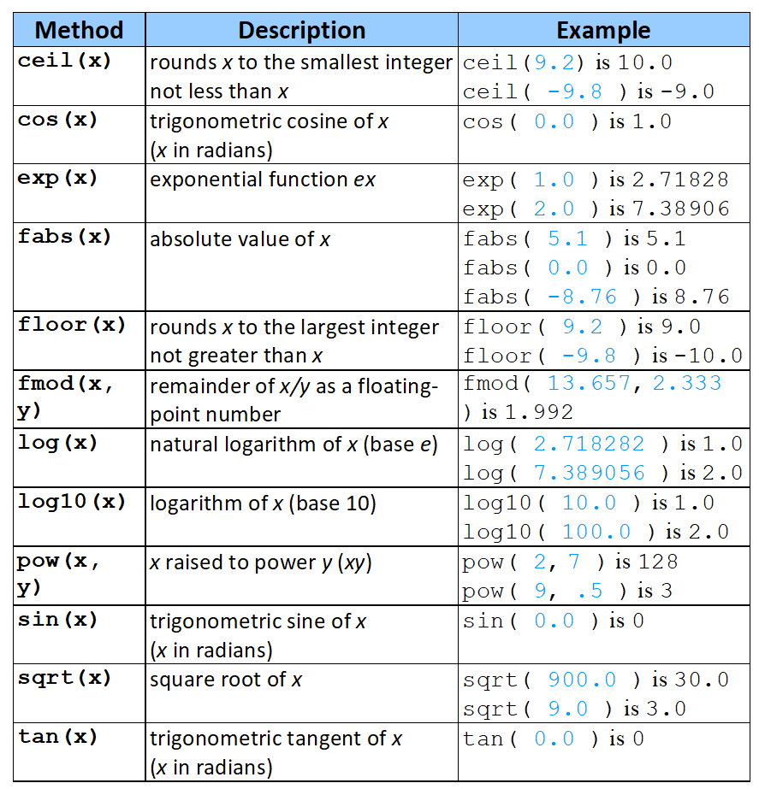

Slide 7
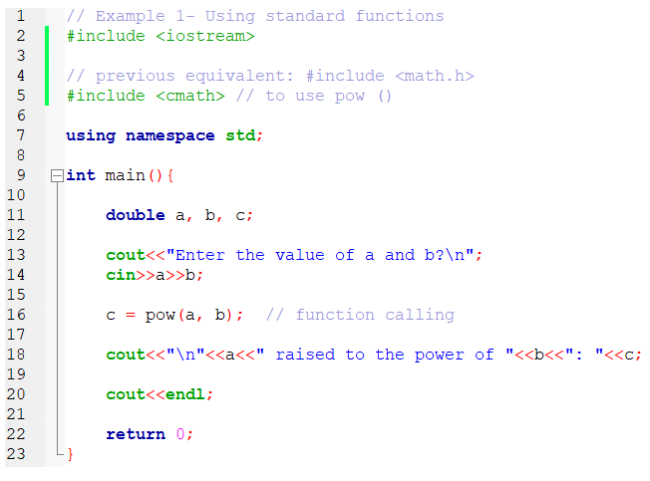
Example 1

Slide 8
Cont’d…
User-defined functions
standard functions may not be enough, to satisfy all users need
e.g., “find the largest of two integers?” // no built-in function
so C++ language provides users to create their own functions
Function structure,
function prototyping (A) // or “declaration”
function definition (B)
Functions are invoked by,
function calling (C)
it is where execution of the function begins

Slide 9
Function Prototyping
Function prototype
tell the compiler about the existence of the function
i.e., its arguments type & return type
Syntax
return-type funcName(arg1-type, arg2-type,...);
use void as the return type, when returning nothing
Example
int square(int); // takes an int, & returns int
int square(int a);
optional to specify parameters’ name

Slide 10
Function Definition
Syntax
return-type funcName(parameter-list) { … // declarations
… // statements }
Parameter list -> (type par1, type par2, …)
comma separated list of parameters
data type is needed for each parameters
use void (or leave blank), when no arguments is received
e.g., int main () {return 0;}

Slide 11
Cont’d…
Return type
the data type of value returned by the function
use void, when nothing is returned
e.g., void main () { } // return 0; not needed
Example
int square(int y)
{
return (y * y);
}
Keyword: return
return data, & the control goes to the function caller

Slide 12
Cont’d…
Function prototype,
must match the function definition
Example
int max(int, int, int); // function prototype
int max(int x, int y, int z) // function definition
{
… // statements
}
Warning: a function cannot be defined inside another function

Slide 13
Function Calling
Function calling (or invoking function)
syntax: funcName(arg1,arg2, …);
Example
square(x); // calls function named square
pass argument x to square
function get its own copy of the arguments // “pass by value”
after the task finished, return the result
a = square(x); // assign square to a
assign the result returned by square to a

Slide 14
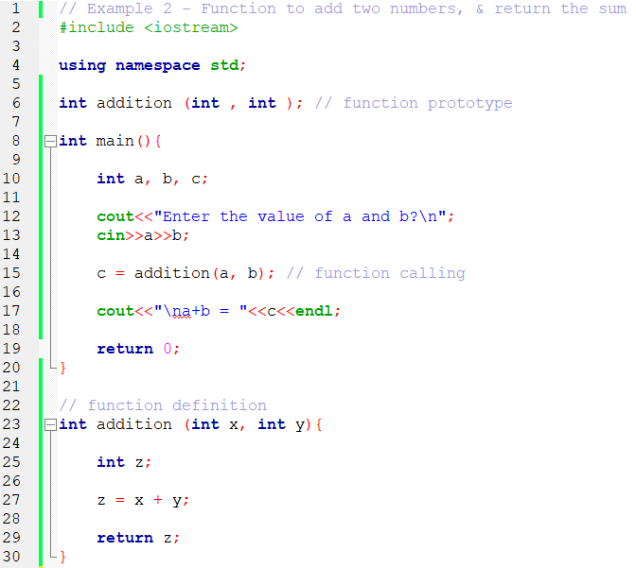
Example 2

Slide 15
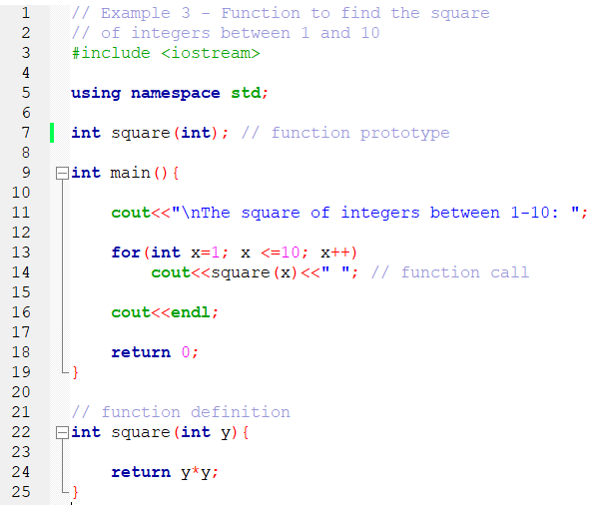
Example 3

Slide 16
Cont’d…
Functions with an empty parameter list,
use void (or leave parameter list empty)
Example
void print(void); // function prototype
optional to specify void
void print( );
print take no arguments,
Also returns no value (or nothing)

Slide 17
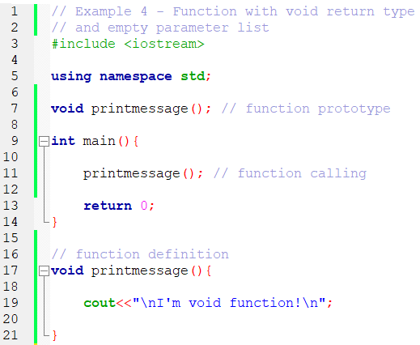
Example 4

Slide 18
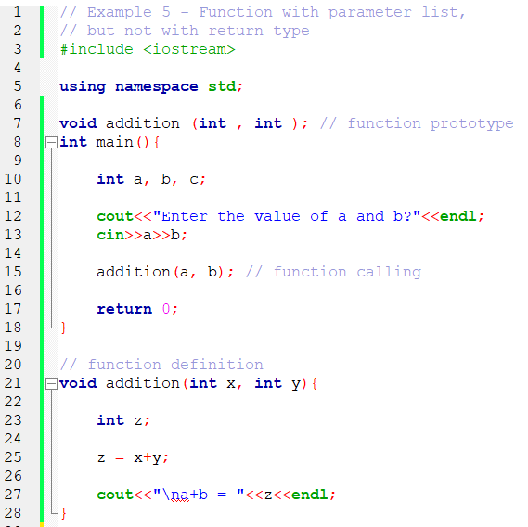
Example 5

Slide 19
Scope of Variables
Scope of variables
define where a variable can be accessed in a program
Local variable
declared in the body { } or inside function ()
only accessed by the function declared it
e.g., variables declared inside the main ()
Global variable
declared outside a function, before the main ()
accessed by all the functions, including the main ()

Slide 20
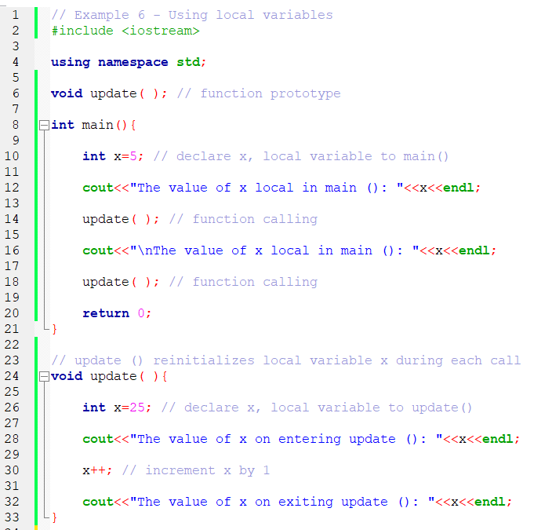
Example 6

Slide 21
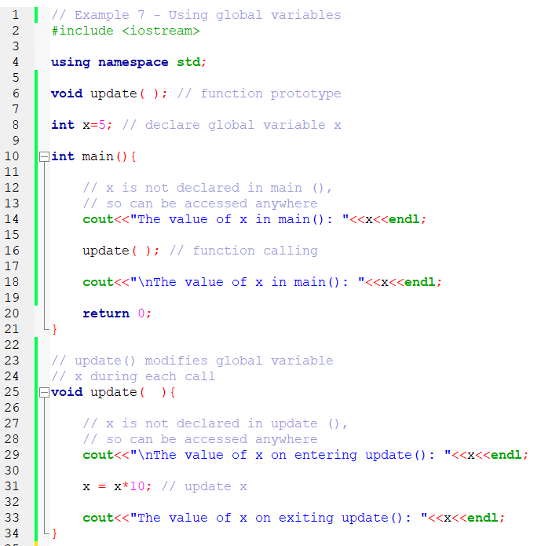
Example 7

Slide 22
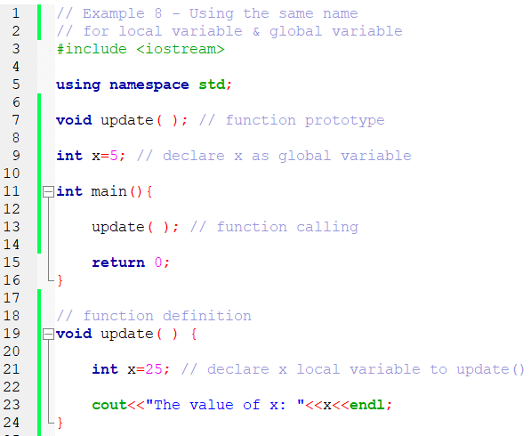
Example 8

Slide 23
Scope Resolution Operator
If a global variable has the same name as the local variable,
local variable is accessed (by default)
Scope resolution operator (::)
used to access a global variable inside a function,
when the function has a local variable with the same name
syntax: ::varName;
Example
cout<<::x;
y = ::x + 3;

Slide 24
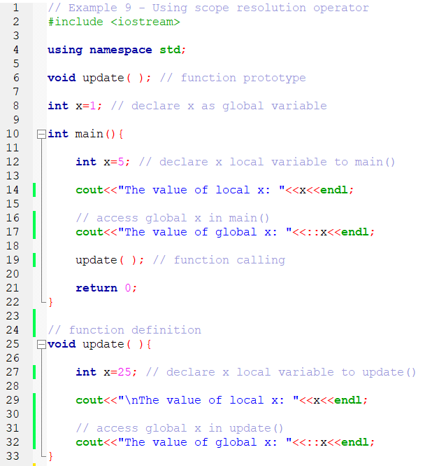
Example 9

Slide 25
Storage Classes
Storage class of variables
determine the period a variable exist or kept inside a memory
Automatic variable
created when a program/function enter its block
destroyed when a program/function leave its block
Example
all local variables of a function (by default)
int main () {int x; return 0;} // implicitly
or declared as auto int x; // explicitly

Slide 26
Cont’d…
Static variable
created when program execution begin
initialized only once, when it’s declared
existed for the duration of program execution
Example
all global variables (by default)
int a = 5; // same as static int a = 5 (explicitly)
int main (){return 0;}
local variables declared, static int x=20; // explicitly
x retain its value b/n function calls
only referenced locally // function declared

Slide 27
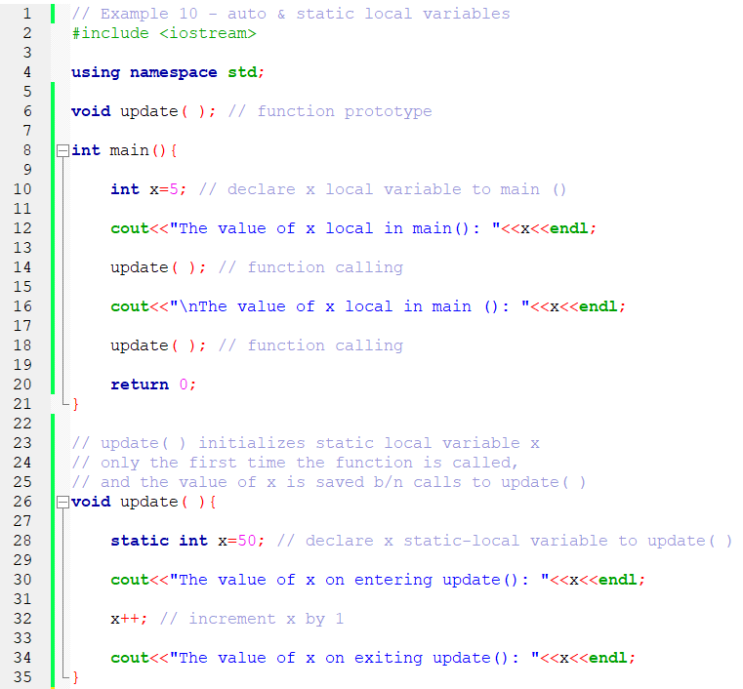
Example 10

Slide 28
Function Calls Stack
Function call stack
also known as “program execution stack”
support function call & return mechanism
use LIFO (Last-In First-Out) to manage function calls
Each time, a function (A) calls another function (B),
a stack frame (or an “activation record”) is pushed to the stack:
Maintain the return address,
i.e., function called (B) need to return to function calling (A)
contain automatic variables,
i.e., function called (B) local variables & parameters

Slide 29
Cont’d…
When function called (B) return, to the function calling (A),
stack frame for the function called (B) is popped from the stack, and
the control transfer to the return address, in the popped stack frame
Function call stack
has a maximum size assigned
“Stack overflow”,
an error that occur when more function calls occurred than the call stack can store their activation records (due to memory limitations)
may result a program crash
https://stackoverflow.com/

Slide 30
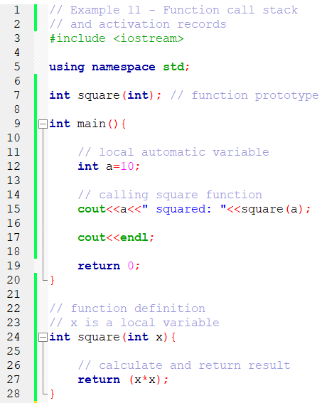
Example 11

Slide 31
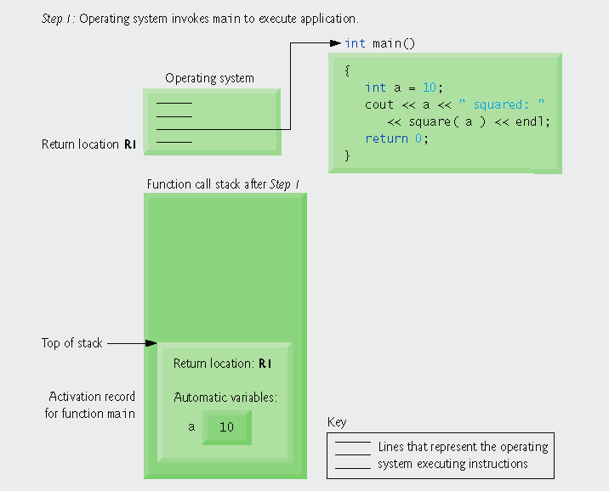
Cont’d…

Slide 32
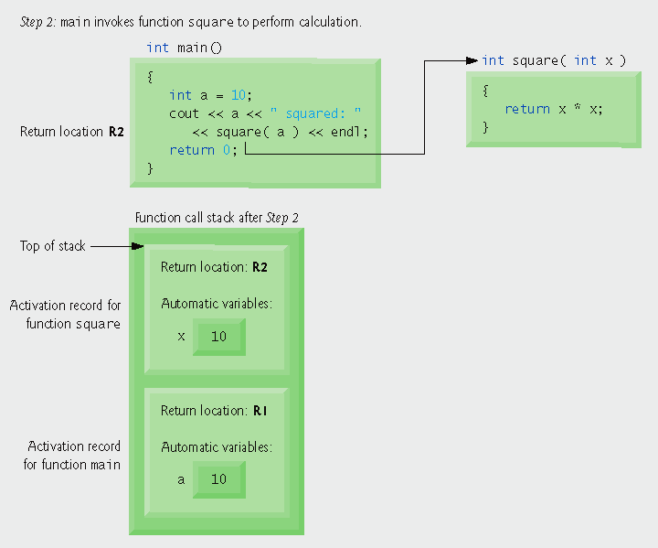
Cont’d…

Slide 33
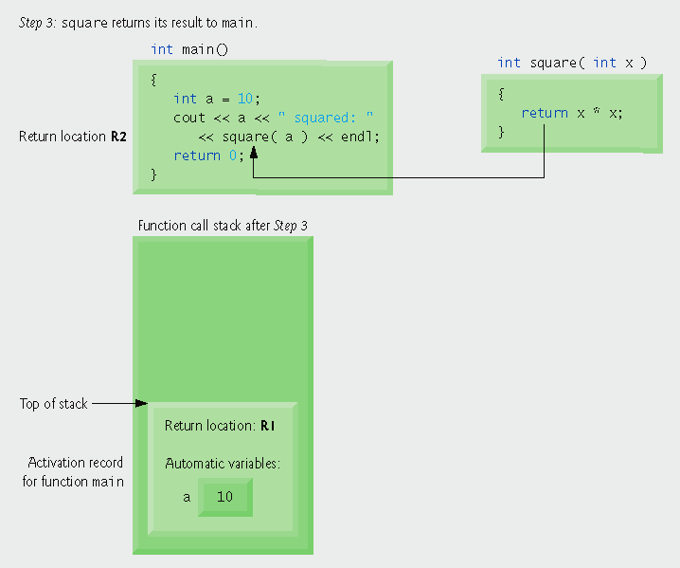
Cont’d…

Slide 34
Passing Arguments to Function
Pass by value
copy of argument value, passed to parameter
changes made to function parameters,
do not affect values of the arguments
thus, prevented from unwanted side effects
Pass by reference
copy of argument address, passed to parameter
changes made to function parameters,
affect or modify values of the arguments

Slide 35
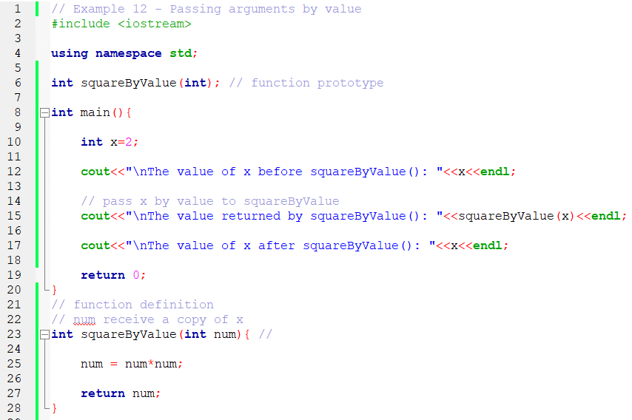
Example 12

Slide 36
Reference Variable
Reference variable(&)
serves an “alias” of another (regular) variable
holds the “address” of referrer variable // like pointer variables
but can be dereferenced implicitly, and
also must be initialized when declared // like constant pointers
Syntax: type &referenceName = referrerName;
Example
int x=5;
int &y=x; // create y an alias for x
cout<<y; // same as cout<<x;
int a=3;
int &b; // error
b=x;

Slide 37
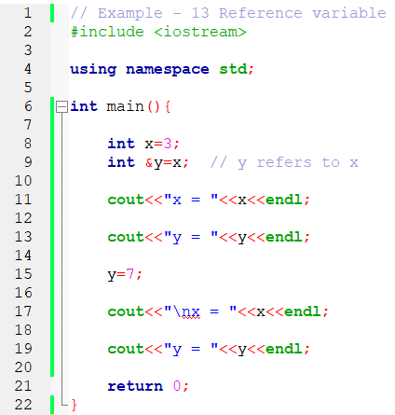
Example 13

Slide 38
Pass by Reference
Reference variable
used as function parameter
e.g., void myReferenceVar(int &y); // fun. prototype
variable name used, in function call
e.g., myReferenceVar(x);
Pointer variable
used as function parameter
e.g., void myPointerVar(int *b); // fun. prototype
& used with an argument, in function calling
e.g., myPointerVar(&a); // arrays do not need &

Slide 39
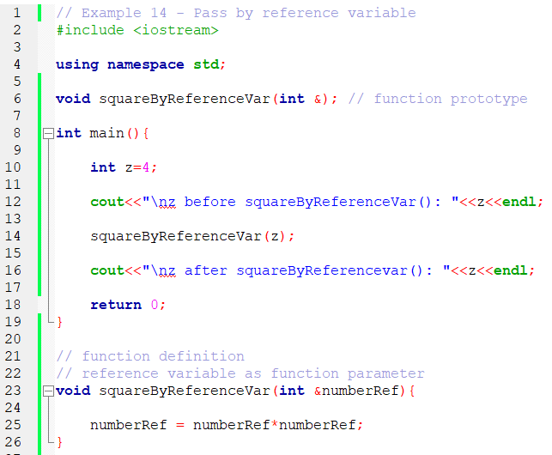
Example 14

Slide 40
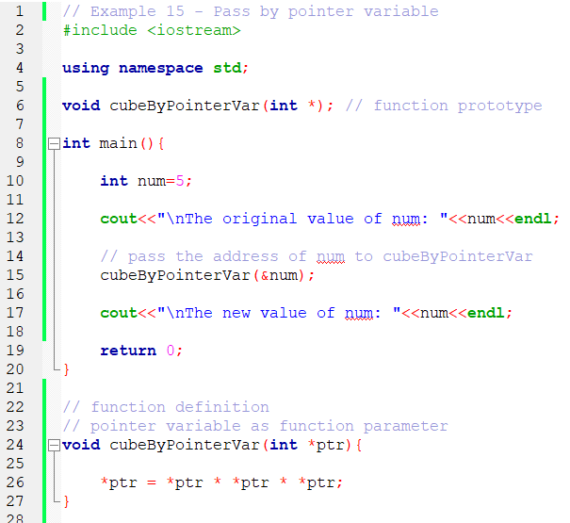
Example 15

Slide 41
Passing Array to Function
Arrays passed by reference
array variable used, in function parameter
e.g., void myArray(int y[], int n); // fun. prototype
don’t need array size // ignored by compiler
Array name used, in function call
e.g., int x[5];
myArray(x, 5); // function call
x contain the address of 1st element
usually, size of array also passed // but not a must
useful to iterate through elements

Slide 42
Cont’d…
Array elements passed by value,
e.g., int y[5]={10, 20, 30, 40, 50};
square(y[3]); // function call; value of x[3] passed
int square(int v); // function prototype
To prevent an array, from being modified,
use const array, in function parameter
e.g., void doNotModify(const int []); // fun. Proto.
For 2D arrays, in function parameter
e.g., void printArray(int[][3]); // function prototype
must specify sizes of subscripts // except the first

Slide 43
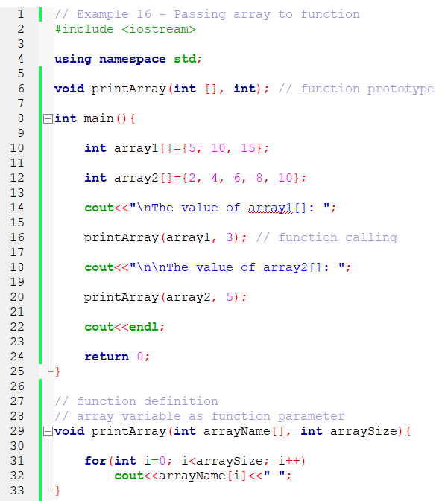
Example 16

Slide 44
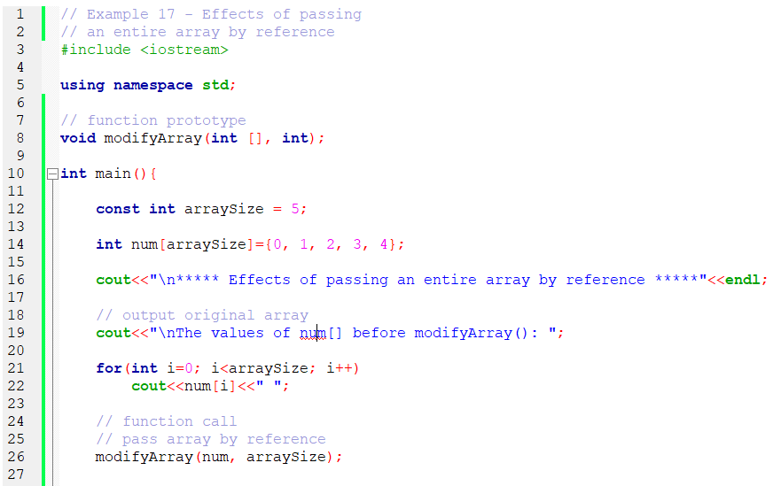
Example 17

Slide 45
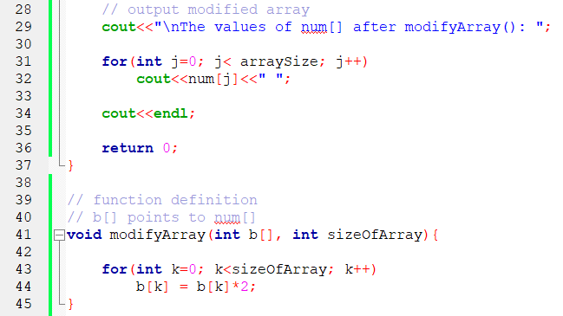
Cont’d…

Slide 46
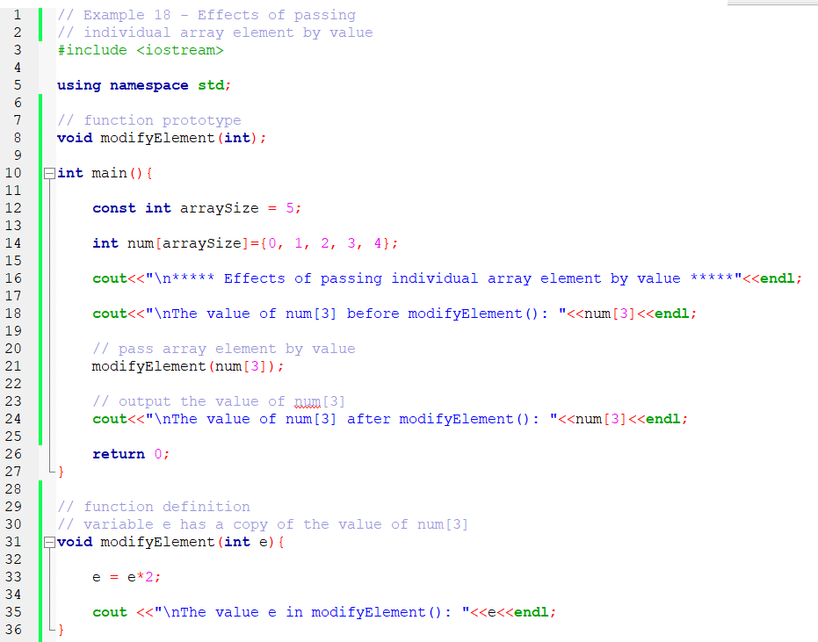
Example 18

Slide 47
Cont’d…

Slide 48
Recursive Function
Recursive function
function that call themselves
can only solve a base case
If not base case,
break the problem into smaller problem(s)
call new copy of function, to work on the smaller problem
slowly converges toward the base case
function call itself, inside return statement
eventually the base case get solved,
answer works way back to up, & solve the entire problem

Slide 49
Cont’d…
Example, to find the factorial of an integer n,
n! = n * (n – 1) * (n – 2) * ( … ) * 1
the recursive relationship: n! = n * (n – 1)!
5! = 5 * 4!
4! = 4 * 3!
3! = 3 * 2!
2! = 2 * 1!
1! = 1 * 0! (note: 0! = 1) = 1
the base case: 1! = 1

Slide 50
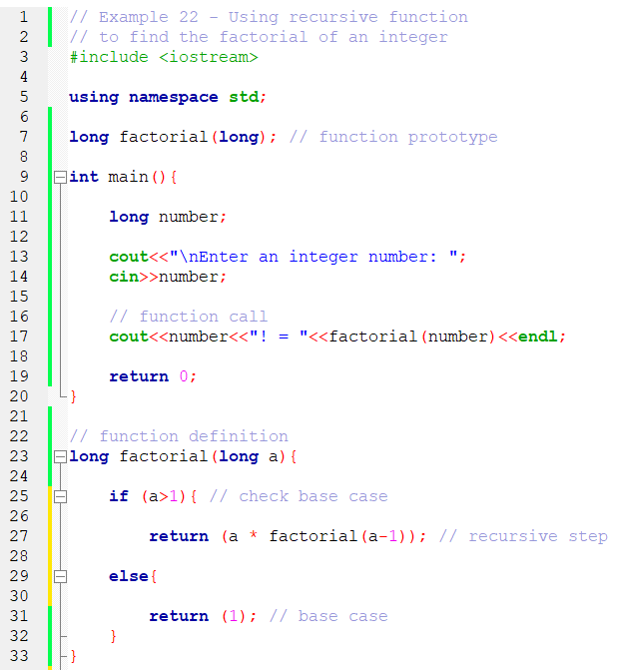
Example 22

Slide 51
Inline Function
Function call overheads (for a compiler):
remember where to return value,
when function execution ends
provide memory,
for function variables
for value returned by function
pass control from function calling,
to the function called
pass control back to the calling function
Solution: inline function

Slide 52
Cont’d…
Inline function definition,
use inline, before return type
appear prior to the main()
copy code into program,
instead of making function call
substitute arguments
Reduce function call overhead
Good for small, & often-used functions

Slide 53
Cont’d…
Inline function must precede,
the function that calls it,
Eliminates the need for function prototyping
Example,
inline double cube(double s)
{
return (s * s * s);
}

Slide 54
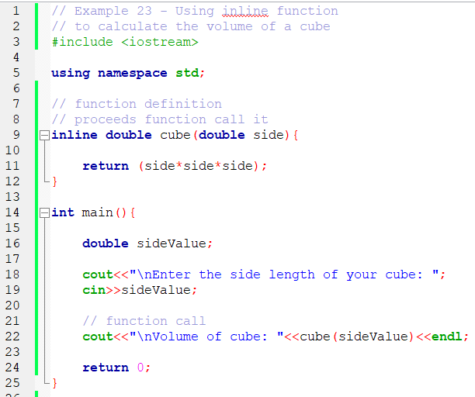
Example 23

Slide 55
Default Arguments
When function called, with an omitted parameters
If not enough parameters,
rightmost go to their defaults
Default values can be,
constants, global variables, or function calls
set defaults, in function prototype
Example
int myFunction(int x=1, int y=2, int z=3);
myFunction(3);
x=3, y & z get defaults (rightmost)

Slide 56
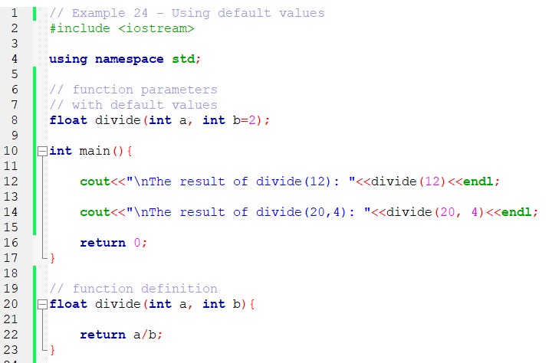
Example 24

Slide 57
Overloaded Function
Function overloading
functions that have the same name,
but d/f parameter sets (number, type, & order)
Example
int square(int x)
{
return (x * x);
}
We can say, “square() is an overloaded function”
float square(float x)
{
return (x * x);
}

Slide 58
Cont’d…
The compiler select the proper function,
based on the number, type, & order of arguments
passed to the function, in the function call.
Commonly used: to create several functions, of the same name,
that perform similar tasks, but work on d/f data types
Warning:
functions can not be overloaded, by return type
e.g., int square(int x){return (x * x);}
float square(int y){return (x * x);} // error

Slide 59
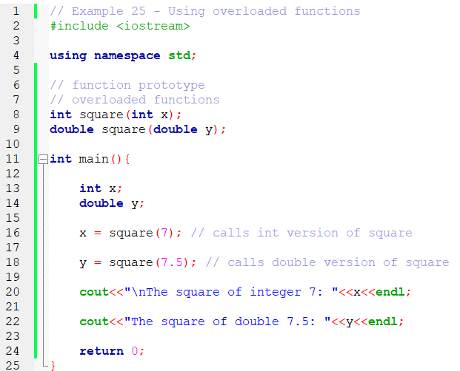
Example 25

Slide 60
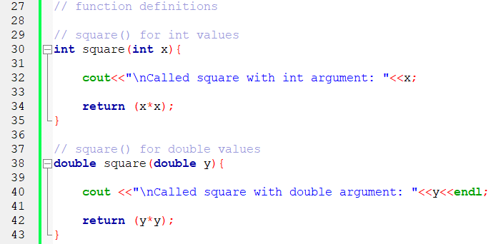
Cont’d…

